Slide 1

Design Example: Serial Adder with Accumulator
ECE 2372 | Modern Digital System Design | Texas Tech University

Slide 2
Lecture Overview
Design Specification
Shift Registers
Serial Adder
Control Circuit
System Integration

Slide 3
Design Specification
Serial Adder with Accumulator | Modern Digital System Design

Slide 4

Design Specification
Design a circuit capable of serially adding two 4-bit binary numbers and storing the results in an accumulator.
$$A+B=S$$
The binary numbers A and B should be loaded in parallel and then fed one bit at-a-time to the serial adder.

Slide 5
S[i]
SUM
4
ST
A[i]
Shift Register
>
2
4
Serial
Adder
Control
Circuit
SH, LD
A
>
B[i]
Shift Register
>
>
4
B

Slide 6

What questions do you have?

Slide 7
Shift Registers
Serial Adder with Accumulator | Modern Digital System Design

Slide 8
Shift Registers
We’ll implement the PIPO shift registers that we discussed in a previous lecture.
Q3
Q2
Q1
Q0
SO
SI
Shift
4-bit Parallel-In,
Parallel-Out
Shift Register
Load
>
D3
D2
D1
D0

Slide 9
Shift Registers
Technically, our shift register is a Moore machine with 7 inputs and 16 states.
We won’t go through the entire design process.
Instead, we can use some logic and our design pattern to speed things up.

Slide 10

Shift Registers
If SH = 1, then shift the bits to the right.
If SH =0 AND LD = 1, then load D into Q.
If SH =0 AND lD = 0, then do nothing.
$$Q_{0}^{+}=SH Q_{1}+SH^{′}LD D_{0}+SH^{′}LD^{′}Q_{0}$$
$$Q_{1}^{+}=SH Q_{2}+SH^{′}LD D_{1}+SH^{′}LD^{′}Q_{1}$$
$$Q_{2}^{+}=SH Q_{3}+SH^{′}LD D_{2}+SH^{′}LD^{′}Q_{2}$$
$$Q_{3}^{+}=SH SI+SH^{′}LD D_{3}+SH^{′}LD^{′}Q_{3}$$

Slide 11
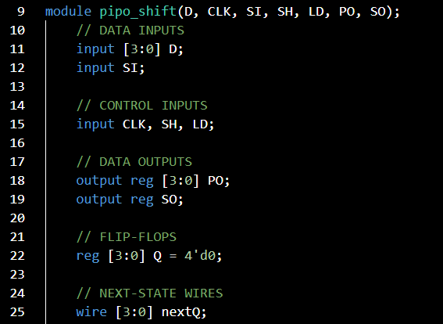
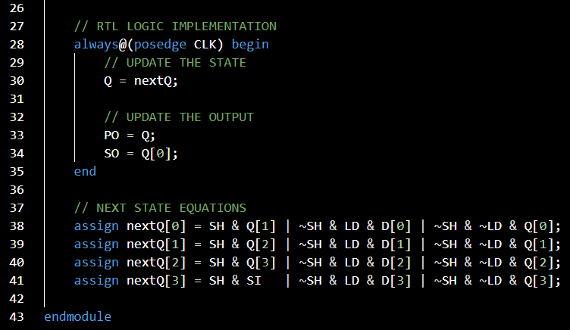

Slide 12
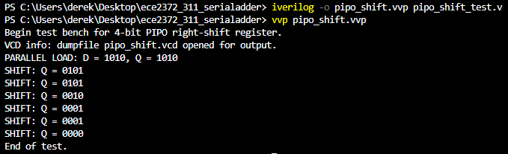

Slide 13
What questions do you have?

Slide 14
Serial Adder
Serial Adder with Accumulator | Modern Digital System Design

Slide 15
Serial Adder
We already have a serial adder, the Full Adder!
But, we need to hang onto the carry for the next addition.

Slide 16
Serial Adder
A
B
S
Full
Adder
Cin
Cout
D
FF
>

Slide 17
Serial Adder
The serial adder is a Mealy circuit with 2 inputs, 1 output, and 2 states.

Slide 18


Serial Adder | State Graph
$$S_{0}$$
$$S_{1}$$
Carry = 0
Carry = 1

Slide 19
Serial Adder | State Graph
00/0,
01/1,
10/1
$$S_{0}$$
$$S_{1}$$
Carry = 0
Carry = 1

Slide 20
Serial Adder | State Graph
11/0
00/0,
01/1,
10/1
$$S_{0}$$
$$S_{1}$$
Carry = 0
Carry = 1

Slide 21
Serial Adder | State Graph
11/0
00/0,
01/1,
10/1
01/0,
10/0,
11/1
$$S_{0}$$
$$S_{1}$$
Carry = 0
Carry = 1

Slide 22
Serial Adder | State Graph
11/0
00/0,
01/1,
10/1
01/0,
10/0,
11/1
$$S_{0}$$
$$S_{1}$$
Carry = 0
Carry = 1
00/1

Slide 23
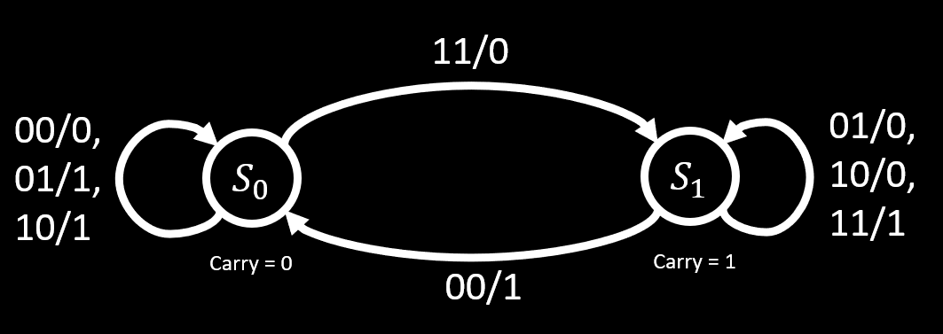
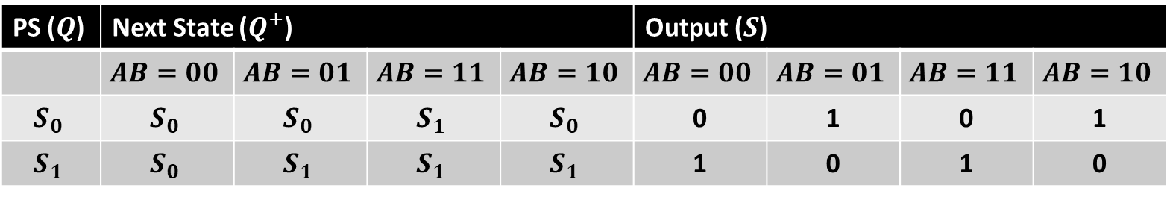
Serial Adder | State Table
PS ($Q$) | Next State ($Q^{+}$) |  |  |  | Output ($S$)
 | $$AB=00$$ | $$AB=01$$ | $$AB=11$$ | $$AB=10$$ | $$AB=00$$ | $$AB=01$$ | $$AB=11$$ | $$AB=10$$
$$S_{0}$$ | $$S_{0}$$ | $$S_{0}$$ | $$S_{1}$$ | $$S_{0}$$ | 0 | 1 | 0 | 1
$$S_{1}$$ | $$S_{0}$$ | $$S_{1}$$ | $$S_{1}$$ | $$S_{1}$$ | 1 | 0 | 1 | 0

Slide 24
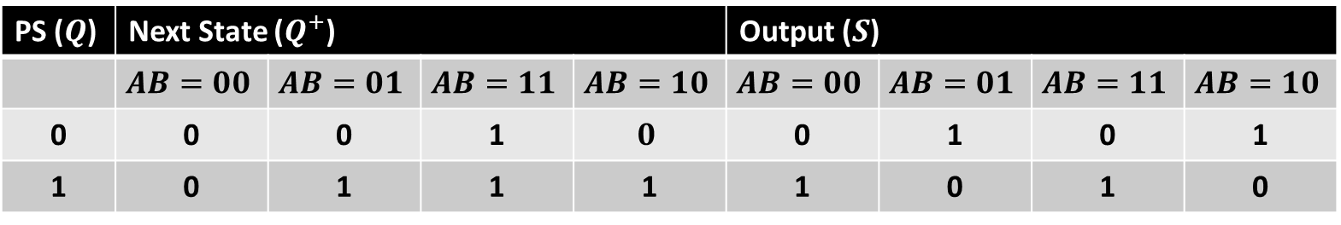
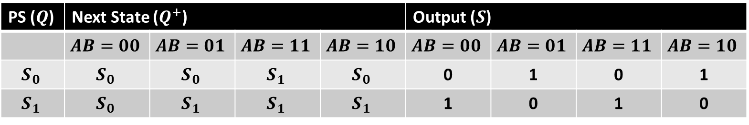
Serial Adder | Transition Table
PS ($Q$) | Next State ($Q^{+}$) |  |  |  | Output ($S$)
 | $$AB=00$$ | $$AB=01$$ | $$AB=11$$ | $$AB=10$$ | $$AB=00$$ | $$AB=01$$ | $$AB=11$$ | $$AB=10$$
0 | 0 | 0 | 1 | $$0$$ | 0 | 1 | 0 | 1
1 | 0 | 1 | 1 | 1 | 1 | 0 | 1 | 0
PS ($Q$) | Next State ($Q^{+}$) |  |  |  | Output ($S$)
 | $$AB=00$$ | $$AB=01$$ | $$AB=11$$ | $$AB=10$$ | $$AB=00$$ | $$AB=01$$ | $$AB=11$$ | $$AB=10$$
$$S_{0}$$ | $$S_{0}$$ | $$S_{0}$$ | $$S_{1}$$ | $$S_{0}$$ | 0 | 1 | 0 | 1
$$S_{1}$$ | $$S_{0}$$ | $$S_{1}$$ | $$S_{1}$$ | $$S_{1}$$ | 1 | 0 | 1 | 0

Slide 25
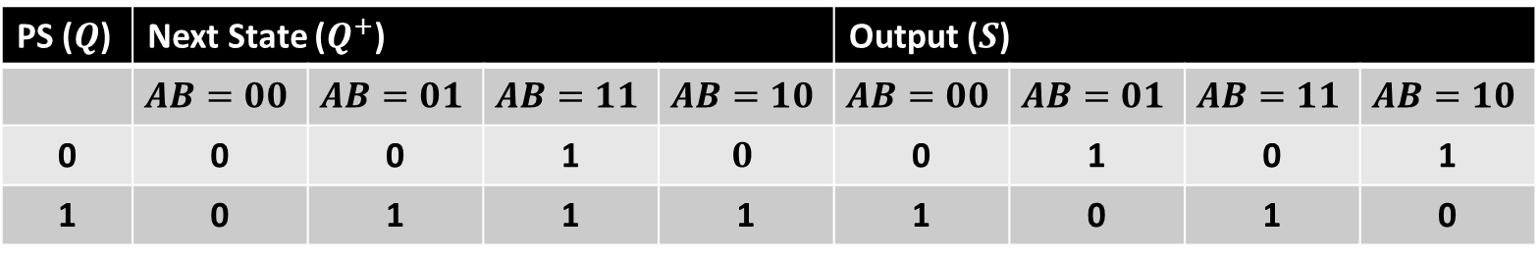
S
AB
A’
A
X
Q’
0
1
0
1
0
1
3
2
Q
1
0
1
0
4
5
7
6
B’
B
B’
PS ($Q$) | Next State ($Q^{+}$) |  |  |  | Output ($S$)
 | $$AB=00$$ | $$AB=01$$ | $$AB=11$$ | $$AB=10$$ | $$AB=00$$ | $$AB=01$$ | $$AB=11$$ | $$AB=10$$
0 | 0 | 0 | 1 | $$0$$ | 0 | 1 | 0 | 1
1 | 0 | 1 | 1 | 1 | 1 | 0 | 1 | 0

Slide 26

S
AB
A’
A
X
Q’
0
1
0
1
0
1
3
2
Q
1
0
1
0
4
5
7
6
B’
B
B’
$$S\left(Q, A, B\right)=Q ⊕ A ⊕ B$$

Slide 27
A+
AB
A’
A
X
Q’
0
0
1
0
0
1
3
2
Q
0
1
1
1
4
5
7
6
B’
B
B’
PS ($Q$) | Next State ($Q^{+}$) |  |  |  | Output ($S$)
 | $$AB=00$$ | $$AB=01$$ | $$AB=11$$ | $$AB=10$$ | $$AB=00$$ | $$AB=01$$ | $$AB=11$$ | $$AB=10$$
0 | 0 | 0 | 1 | $$0$$ | 0 | 1 | 0 | 1
1 | 0 | 1 | 1 | 1 | 1 | 0 | 1 | 0

Slide 28

Q+
AB
A’
A
X
Q’
0
0
1
0
0
1
3
2
Q
0
1
1
1
4
5
7
6
B’
B
B’
$$Q^{+}\left(Q, A,B\right)=QB+$$

Slide 29

Q+
AB
A’
A
X
Q’
0
0
1
0
0
1
3
2
Q
0
1
1
1
4
5
7
6
B’
B
B’
$$Q^{+}\left(Q, A,B\right)=QB+AB+$$

Slide 30
A+
AB
A’
A
X
Q’
0
0
1
0
0
1
3
2
Q
0
1
1
1
4
5
7
6
B’
B
B’
$$Q^{+}\left(Q, A,B\right)=QB+AB+QA$$

Slide 31

Serial Adder
These are the same equations that we have already seen for the Full Adder.
$$S\left(Q, A, B\right)=Q ⊕ A ⊕ B$$
$$Q^{+}\left(Q, A,B\right)=QB+AB+QA$$

Slide 32
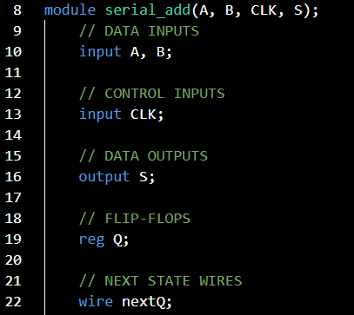
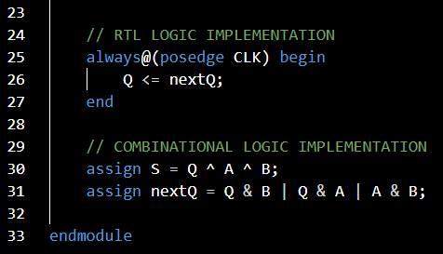

Slide 33
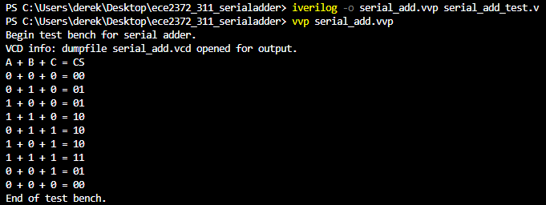

Slide 34
What questions do you have?

Slide 35
Control Circuit
Serial Adder with Accumulator | Modern Digital System Design

Slide 36
Control Circuit
The control circuit has,
2 inputs, ST (start) and CLK.
2 outputs, SH (Shift) and LD (Load)

Slide 37
Control Circuit
The control circuit needs to,
Load the initial values into the shift registers.
Have the shift registers push all 4-bits through the serial adder.
Stop.
Let’s use a Mealy circuit to implement this.

Slide 38




Control Circuit | State Graph
$$S_{0}$$
$$S_{1}$$
At Rest
Load D
$$S_{2}$$
Add 2nd
$$S_{4}$$
$$S_{3}$$
Add 4th
Add 3rd

Slide 39
Control Circuit | State Graph
ST/SH, LD
0/00
$$S_{0}$$
$$S_{1}$$
At Rest
Load D
$$S_{2}$$
Add 2nd
$$S_{4}$$
$$S_{3}$$
Add 4th
Add 3rd

Slide 40
Control Circuit | State Graph
ST/SH, LD
0/00
1/01
$$S_{0}$$
$$S_{1}$$
At Rest
Load D
$$S_{2}$$
Add 2nd
$$S_{4}$$
$$S_{3}$$
Add 4th
Add 3rd

Slide 41
Control Circuit | State Graph
ST/SH, LD
0/00
0/10,
1/10
1/01
$$S_{0}$$
$$S_{1}$$
At Rest
Load D
$$S_{2}$$
Add 2nd
$$S_{4}$$
$$S_{3}$$
Add 4th
Add 3rd

Slide 42
Control Circuit | State Graph
ST/SH, LD
0/00
0/10,
1/10
1/01
$$S_{0}$$
$$S_{1}$$
At Rest
Load D
$$S_{2}$$
Add 2nd
$$S_{4}$$
$$S_{3}$$
0/10,
1/10
Add 4th
Add 3rd

Slide 43
Control Circuit | State Graph
ST/SH, LD
0/00
0/10,
1/10
1/01
$$S_{0}$$
$$S_{1}$$
At Rest
Load D
$$S_{2}$$
Add 2nd
0/10,
1/10
$$S_{4}$$
$$S_{3}$$
0/10,
1/10
Add 4th
Add 3rd

Slide 44
Control Circuit | State Graph
ST/SH, LD
0/00
0/10,
1/10
1/01
$$S_{0}$$
$$S_{1}$$
At Rest
Load D
0/10,
1/10
$$S_{2}$$
Add 2nd
0/10,
1/10
$$S_{4}$$
$$S_{3}$$
0/10,
1/10
Add 4th
Add 3rd

Slide 45
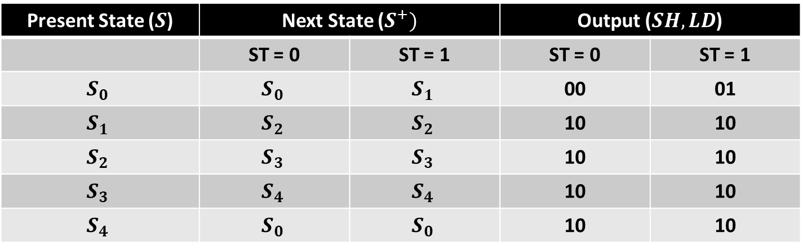
Control Circuit | State Table
Present State ($S$) | Next State ($S^{+})$ |  | Output ($SH,LD$)
 | ST = 0 | ST = 1 | ST = 0 | ST = 1
$$S_{0}$$ | $$S_{0}$$ | $$S_{1}$$ | 00 | 01
$$S_{1}$$ | $$S_{2}$$ | $$S_{2}$$ | 10 | 10
$$S_{2}$$ | $$S_{3}$$ | $$S_{3}$$ | 10 | 10
$$S_{3}$$ | $$S_{4}$$ | $$S_{4}$$ | 10 | 10
$$S_{4}$$ | $$S_{0}$$ | $$S_{0}$$ | 10 | 10

Slide 46
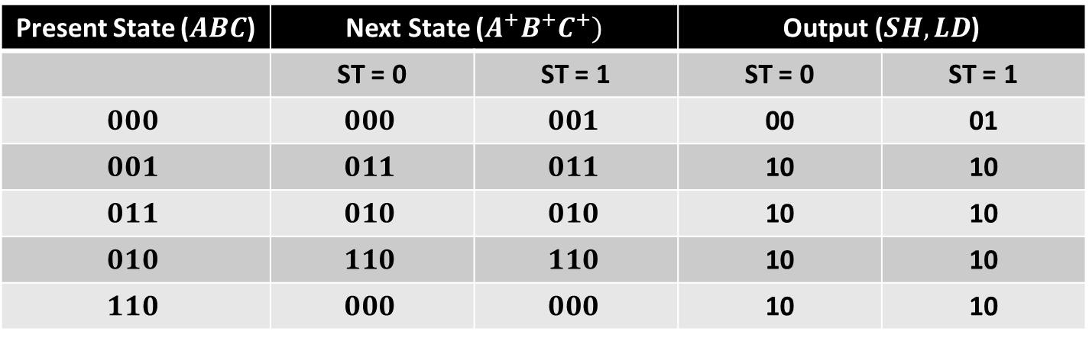

Control Circuit | Transition Table
Present State ($ABC$) | Next State ($A^{+}B^{+}C^{+})$ |  | Output ($SH,LD$)
 | ST = 0 | ST = 1 | ST = 0 | ST = 1
$$000$$ | $$000$$ | $$001$$ | 00 | 01
$$001$$ | $$011$$ | $$011$$ | 10 | 10
$$011$$ | $$010$$ | $$010$$ | 10 | 10
$$010$$ | $$110$$ | $$110$$ | 10 | 10
$$110$$ | $$000$$ | $$000$$ | 10 | 10
Present State ($S$) | Next State ($S^{+})$ |  | Output ($SH,LD$)
 | ST = 0 | ST = 1 | ST = 0 | ST = 1
$$S_{0}$$ | $$S_{0}$$ | $$S_{1}$$ | 00 | 01
$$S_{1}$$ | $$S_{2}$$ | $$S_{2}$$ | 10 | 10
$$S_{2}$$ | $$S_{3}$$ | $$S_{3}$$ | 10 | 10
$$S_{3}$$ | $$S_{4}$$ | $$S_{4}$$ | 10 | 10
$$S_{4}$$ | $$S_{0}$$ | $$S_{0}$$ | 10 | 10

Slide 47

Control Circuit | N-S and Output Equations
Present State ($ABC$) | Next State ($A^{+}B^{+}C^{+})$ |  | Output ($SH,LD$)
 | ST = 0 | ST = 1 | ST = 0 | ST = 1
$$000$$ | $$000$$ | $$001$$ | 00 | 01
$$001$$ | $$011$$ | $$011$$ | 10 | 10
$$011$$ | $$010$$ | $$010$$ | 10 | 10
$$010$$ | $$110$$ | $$110$$ | 10 | 10
$$110$$ | $$000$$ | $$000$$ | 10 | 10
For this one, it’ll probably be easier if we start by getting the
General minterm expansion for each output and next state.

Slide 48
Control Circuit | N-S and Output Equations
Present State ($ABC$) | Next State ($A^{+}B^{+}C^{+})$ |  | Output ($SH,LD$)
 | ST = 0 | ST = 1 | ST = 0 | ST = 1
$$000$$ | $$000$$ | $$001$$ | 00 | 01
$$001$$ | $$011$$ | $$011$$ | 10 | 10
$$011$$ | $$010$$ | $$010$$ | 10 | 10
$$010$$ | $$110$$ | $$110$$ | 10 | 10
$$110$$ | $$000$$ | $$000$$ | 10 | 10
Minterm
+8
+8

Slide 49

Control Circuit | N-S and Output Equations
Present State ($ABC$) | Next State ($A^{+}B^{+}C^{+})$ |  | Output ($SH,LD$)
 | ST = 0 | ST = 1 | ST = 0 | ST = 1
$$000$$ | $$000$$ | $$001$$ | 00 | 01
$$001$$ | $$011$$ | $$011$$ | 10 | 10
$$011$$ | $$010$$ | $$010$$ | 10 | 10
$$010$$ | $$110$$ | $$110$$ | 10 | 10
$$110$$ | $$000$$ | $$000$$ | 10 | 10
Minterm
+8
+8
$$A^{+}\left(ST,A, B, C\right)=\sum_{m}{\left(2, 10\right)+\sum_{d}{\left(4, 5, 7, 12, 13, 15\right)}}$$

Slide 50
Control Circuit | N-S and Output Equations
Present State ($ABC$) | Next State ($A^{+}B^{+}C^{+})$ |  | Output ($SH,LD$)
 | ST = 0 | ST = 1 | ST = 0 | ST = 1
$$000$$ | $$000$$ | $$001$$ | 00 | 01
$$001$$ | $$011$$ | $$011$$ | 10 | 10
$$011$$ | $$010$$ | $$010$$ | 10 | 10
$$010$$ | $$110$$ | $$110$$ | 10 | 10
$$110$$ | $$000$$ | $$000$$ | 10 | 10
Minterm
+8
+8
$$B^{+}\left(ST,A, B, C\right)=\sum_{m}{\left(1,2,3,9,10,11\right)+\sum_{d}{\left(4, 5, 7, 12, 13, 15\right)}}$$

Slide 51

Control Circuit | N-S and Output Equations
Present State ($ABC$) | Next State ($A^{+}B^{+}C^{+})$ |  | Output ($SH,LD$)
 | ST = 0 | ST = 1 | ST = 0 | ST = 1
$$000$$ | $$000$$ | $$001$$ | 00 | 01
$$001$$ | $$011$$ | $$011$$ | 10 | 10
$$011$$ | $$010$$ | $$010$$ | 10 | 10
$$010$$ | $$110$$ | $$110$$ | 10 | 10
$$110$$ | $$000$$ | $$000$$ | 10 | 10
Minterm
+8
+8
$$C^{+}\left(ST,A, B, C\right)=\sum_{m}{\left(1, 8, 9\right)+\sum_{d}{\left(4, 5, 7, 12, 13, 15\right)}}$$

Slide 52
Control Circuit | N-S and Output Equations
Present State ($ABC$) | Next State ($A^{+}B^{+}C^{+})$ |  | Output ($SH,LD$)
 | ST = 0 | ST = 1 | ST = 0 | ST = 1
$$000$$ | $$000$$ | $$001$$ | 00 | 01
$$001$$ | $$011$$ | $$011$$ | 10 | 10
$$011$$ | $$010$$ | $$010$$ | 10 | 10
$$010$$ | $$110$$ | $$110$$ | 10 | 10
$$110$$ | $$000$$ | $$000$$ | 10 | 10
Minterm
+8
+8
$$SH\left(ST,A, B, C\right)=\sum_{m}{\left(1,2,3,6,9,10,11,14\right)+\sum_{d}{\left(4, 5, 7, 12, 13, 15\right)}}$$

Slide 53

Control Circuit | N-S and Output Equations
Present State ($ABC$) | Next State ($A^{+}B^{+}C^{+})$ |  | Output ($SH,LD$)
 | ST = 0 | ST = 1 | ST = 0 | ST = 1
$$000$$ | $$000$$ | $$001$$ | 00 | 01
$$001$$ | $$011$$ | $$011$$ | 10 | 10
$$011$$ | $$010$$ | $$010$$ | 10 | 10
$$010$$ | $$110$$ | $$110$$ | 10 | 10
$$110$$ | $$000$$ | $$000$$ | 10 | 10
Minterm
+8
+8
$$LD\left(ST,A, B, C\right)=\sum_{m}{\left(8\right)+\sum_{d}{\left(4, 5, 7, 12, 13, 15\right)}}$$

Slide 54

$$A^{+}\left(ST,A, B, C\right)=\sum_{m}{\left(2, 10\right)+\sum_{d}{\left(4, 5, 7, 12, 13, 15\right)}}$$
B’
B
0
0
0
1
A’
ST’
0
1
3
2
X
X
X
0
4
5
7
6
A
X
X
X
0
ST
12
13
15
14
0
0
0
1
A’
8
9
11
10
C’
C
C’

Slide 55

$$A^{+}\left(ST,A, B, C\right)=BC′$$
B’
B
0
0
0
1
A’
ST’
0
1
3
2
X
X
X
0
4
5
7
6
A
X
X
X
0
ST
12
13
15
14
0
0
0
1
A’
8
9
11
10
C’
C
C’

Slide 56
$$B^{+}\left(ST,A, B, C\right)=\sum_{m}{\left(1,2,3,9,10,11\right)+\sum_{d}{\left(4, 5, 7, 12, 13, 15\right)}}$$
B’
B
0
1
1
1
A’
ST’
0
1
3
2
X
X
X
0
4
5
7
6
A
X
X
X
0
ST
12
13
15
14
0
1
1
1
A’
8
9
11
10
C’
C
C’

Slide 57

$$B^{+}\left(ST,A, B, C\right)=C+$$
B’
B
0
1
1
1
A’
ST’
0
1
3
2
X
X
X
0
4
5
7
6
A
X
X
X
0
ST
12
13
15
14
0
1
1
1
A’
8
9
11
10
C’
C
C’

Slide 58
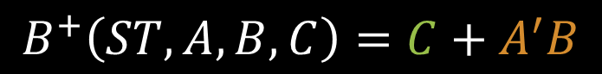
$$B^{+}\left(ST,A, B, C\right)=C+A^{′}B$$
B’
B
0
1
1
1
A’
ST’
0
1
3
2
X
X
X
0
4
5
7
6
A
X
X
X
0
ST
12
13
15
14
0
1
1
1
A’
8
9
11
10
C’
C
C’

Slide 59

$$C^{+}\left(ST,A, B, C\right)=\sum_{m}{\left(1, 8, 9\right)+\sum_{d}{\left(4, 5, 7, 12, 13, 15\right)}}$$
B’
B
0
1
0
0
A’
ST’
0
1
3
2
X
X
X
0
4
5
7
6
A
X
X
X
0
ST
12
13
15
14
1
1
0
0
A’
8
9
11
10
C’
C
C’

Slide 60

$$C^{+}\left(ST,A, B, C\right)=B^{′}C+$$
B’
B
0
1
0
0
A’
ST’
0
1
3
2
X
X
X
0
4
5
7
6
A
X
X
X
0
ST
12
13
15
14
1
1
0
0
A’
8
9
11
10
C’
C
C’

Slide 61
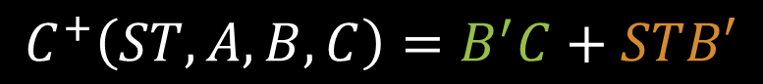
$$C^{+}\left(ST,A, B, C\right)=B^{′}C+STB′$$
B’
B
0
1
0
0
A’
ST’
0
1
3
2
X
X
X
0
4
5
7
6
A
X
X
X
0
ST
12
13
15
14
1
1
0
0
A’
8
9
11
10
C’
C
C’

Slide 62
$$SH\left(ST,A, B, C\right)=\sum_{m}{\left(1,2,3,6,9,10,11,14\right)+\sum_{d}{\left(4, 5, 7, 12, 13, 15\right)}}$$
B’
B
0
1
1
1
A’
ST’
0
1
3
2
X
X
X
1
4
5
7
6
A
X
X
X
1
ST
12
13
15
14
0
1
1
1
A’
8
9
11
10
C’
C
C’

Slide 63

$$SH\left(ST,A, B, C\right)=B+$$
B’
B
0
1
1
1
A’
ST’
0
1
3
2
X
X
X
1
4
5
7
6
A
X
X
X
1
ST
12
13
15
14
0
1
1
1
A’
8
9
11
10
C’
C
C’

Slide 64

$$SH\left(ST,A, B, C\right)=B+C$$
B’
B
0
1
1
1
A’
ST’
0
1
3
2
X
X
X
1
4
5
7
6
A
X
X
X
1
ST
12
13
15
14
0
1
1
1
A’
8
9
11
10
C’
C
C’

Slide 65

$$LD\left(ST,A, B, C\right)=\sum_{m}{\left(8\right)+\sum_{d}{\left(4, 5, 7, 12, 13, 15\right)}}$$
B’
B
0
0
0
0
A’
ST’
0
1
3
2
X
X
X
0
4
5
7
6
A
X
X
X
0
ST
12
13
15
14
1
0
0
0
A’
8
9
11
10
C’
C
C’

Slide 66

$$LD\left(ST,A, B, C\right)=STB^{′}C′$$
B’
B
0
0
0
0
A’
ST’
0
1
3
2
X
X
X
0
4
5
7
6
A
X
X
X
0
ST
12
13
15
14
1
0
0
0
A’
8
9
11
10
C’
C
C’

Slide 67





Control Circuit | N-S and Output Equations
$$A^{+}\left(ST,A, B, C\right)=BC′$$
$$B^{+}\left(ST,A, B, C\right)=C+A^{′}B$$
$$C^{+}\left(ST,A, B, C\right)=B^{′}C+STB′$$
$$SH\left(ST,A, B, C\right)=B+C$$
$$LD\left(ST,A, B, C\right)=STB^{′}C′$$

Slide 68
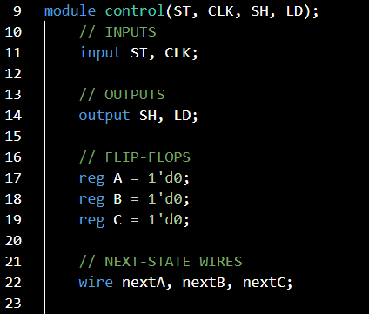
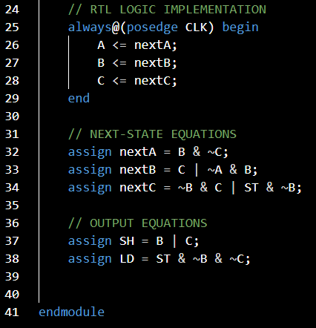

Slide 69
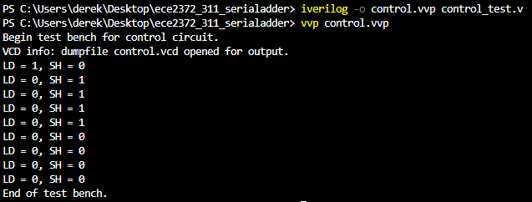

Slide 70
What questions do you have?

Slide 71
System Integration
Serial Adder with Accumulator | Modern Digital System Design

Slide 72
System Integration
We’re finally ready to put it all together!
We’ll implement a top module that integrates all of the components that we’ve been working on.

Slide 73
S[i]
SUM
4
ST
A[i]
Shift Register
>
2
4
Serial
Adder
Control
Circuit
SH, LD
A
>
B[i]
Shift Register
>
>
4
B

Slide 74
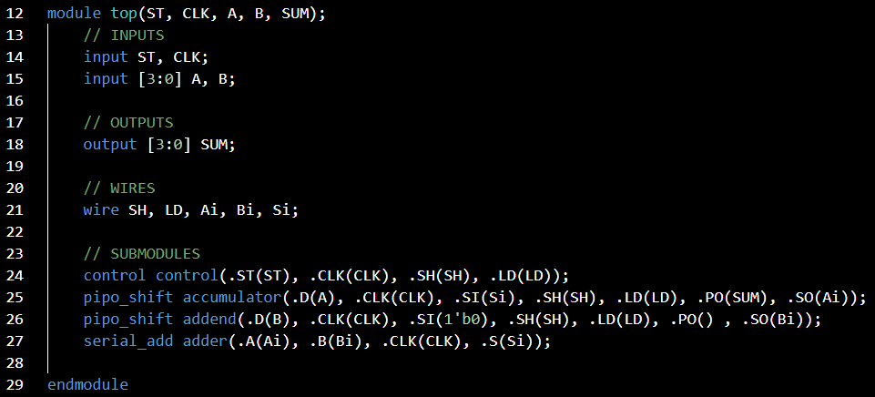

Slide 75
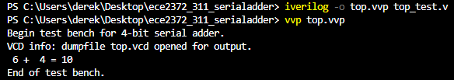

Slide 76
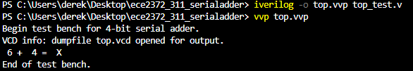
Issue with the PIPO Shifter

Slide 77
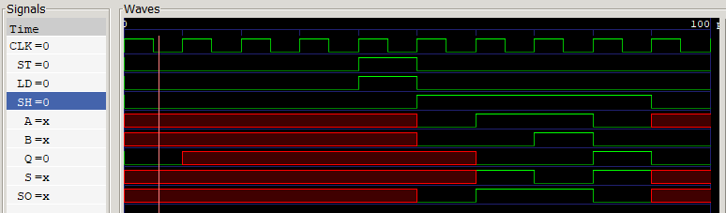
Issue with the PIPO Shifter

Slide 78
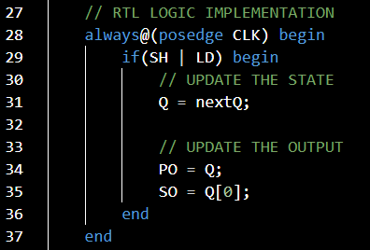
Issue with the PIPO Shifter

Slide 79
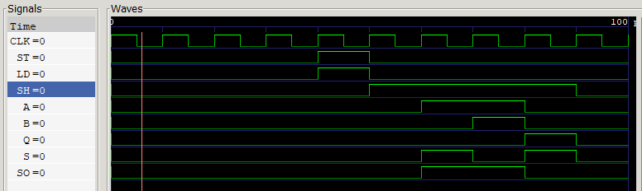
Issue with the PIPO Shifter

Slide 80
What questions do you have?

Slide 81
Lecture Recap
Design Specification
Shift Registers
Serial Adder
Control Circuit
System Integration

Slide 82
Design Example: Serial Adder with Accumulator
ECE 2372 | Modern Digital System Design | Texas Tech University

